Slide 1
IOT BASED WHEELCHAIR FALL DETECTION USING NODEMCU
MICROPROCESSORS AND MICROCONTROLLERS MINI PROJECT
UNDER GUIDANCE OF Dr. Nagaraja J.
DEPT. OF COMPUTER SCIENCE AND ENGINEERING,
DSCE,
BENGALURU.

Slide 2
GROUP MEMBERS
NAME | ANUPAM KUMAR | DEEPAK PARMAR | MEET SAKARIYA
USN | 1DS17CS707 | 1DS17CS716 | 1DS17CS724
Email | kumaranupam068.ak@gmail.com | deepak15parmar@gmail.com | meetsakariya29@gmail.com
SEM | 4 D | 4 D | 4 D

Slide 3
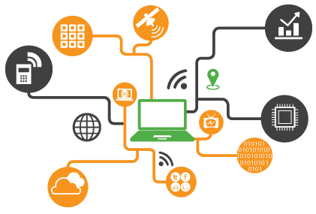
WHAT IS IoT?
The Internet of Things, or "IoT" for short, is about extending the power of the internet beyond computers and smartphones to a whole range of other things, processes and environments. Those "connected" things are used to gather information, send information back, or both. IoT allows businesses and people to be more connected to the world around them and to do more meaningful, higher-level work.

Slide 4
COMPONENTS REQUIRED
NODEMCU ESP8266
MPU6050 IMU
LED
5V Piezo Buzzer
BREADBOARD
JUMPER WIRES (MALE TO MALE)

Slide 5
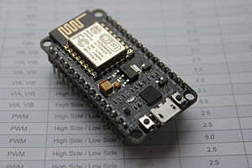
NODEMCU ESP8266
NodeMCU is an open source IoT platform.It includes firmware which runs on the ESP8266 Wi-Fi SoC from Espressif Systems, and hardware which is based on the ESP-12 module.The term "NodeMCU" by default refers to the firmware rather than the development kits. The firmware uses the Lua scripting language. It is based on the eLua project, and built on the Espressif Non-OS SDK for ESP8266. It uses many open source projects, such as lua-cjson and SPIFFS.

Slide 6
NODEMCU ESP8266 (contd.)
Developer- ESP8266 Opensource Community
Type- Single-board microcontroller
Operating system- XTOS
CPU- ESP8266
Memory- 128kBytes
Storage- 4MBytes
Power- USB

Slide 7
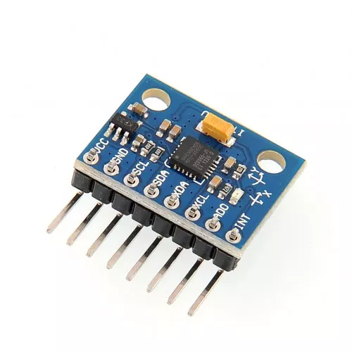
MPU6050
The MPU-6050 devices combine a 3-axis gyroscope and a 3-axis accelerometer on the same silicon die, together with an onboard Digital Motion Processor™ (DMP™), which processes complex 6-axis MotionFusion algorithms. The device can access external magnetometers or other sensors through an auxiliary master I²C bus, allowing the devices to gather a full set of sensor data without intervention from the system processor.

Slide 8
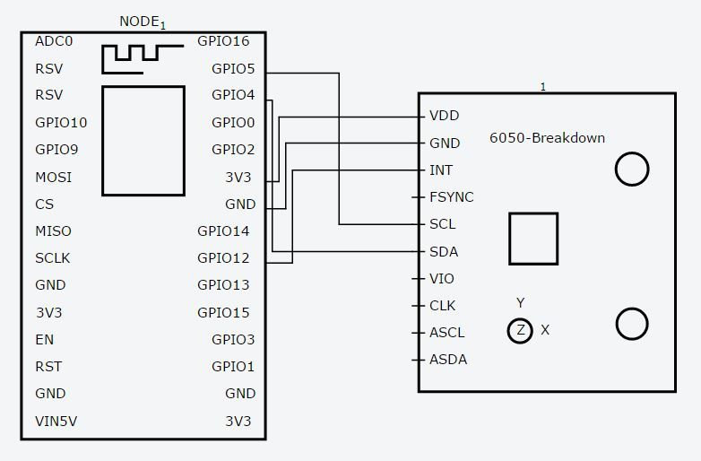
CIRCUIT DIAGRAM

Slide 9
CONCLUSION
The proposed IoT-based fall detection system will enable family and caregivers to be immediately notified of the event and remotely monitor the individual. Integrated within a smart home environment, the proposed IoT-based fall detection system can improve the quality of life among older adults.

Slide 10
THE END

